Slide 1
TA 111: Technical Arts
2023-24 II
Lecture 21-1
Intersection of Solids - I
Dr. Syam Nair
Department of Civil Engineering
IIT Kanpur
Office: FB 307
Phone: 6424
Email: syamnair@iitk.ac.in

Slide 2
Mandatory Reading
Thomas E. French, “Engineering Drawing and Graphics Technology”
Chapter 10 – Surface Intersections

Slide 3
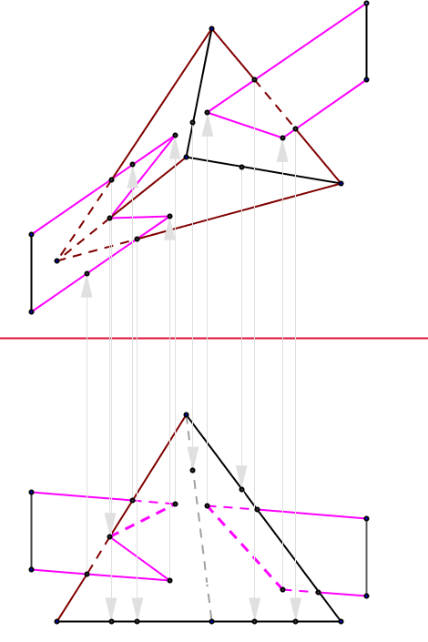
Intersection of a Plane and a Pyramid
A_{h}
Q_{h}
Cutting Plane Method
Visibility needs to be found for:
Path of intersection
Plane and solid
1_{h}
4_{h}
S_{h}
O_{h}
5_{h}
3_{h}
C_{h}
P_{h}
2_{h}
B_{h}
R_{h}
H
F
O_{v}
P_{v}
1_{v}
4_{v}
3_{v}
Q_{v}
R_{v}
2_{v}
5_{v}
S_{v}
Complete Solution
B_{v}
A_{v}
C_{v}

Slide 4
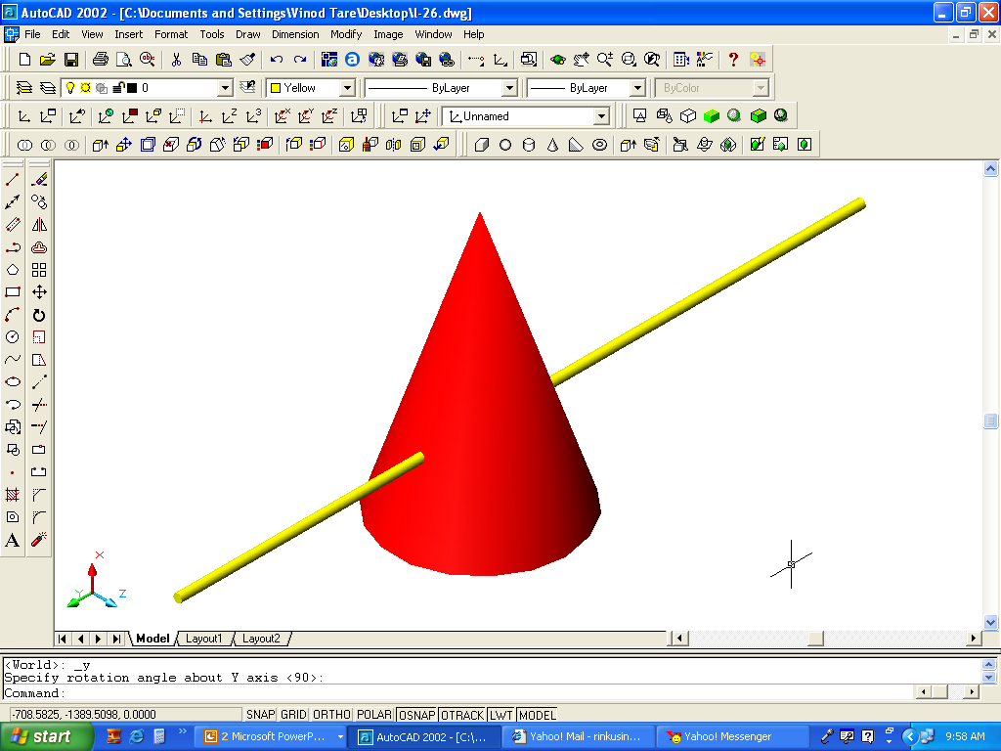
Intersection of a Line and a Cone
Given a line and a cone, find the points of intersection
Select a cutting plane passing through the points V, X, and Y
To get this this: Take points X and Y on given line, get their projections in HV and FV
Extend the plane to base and locate points R and S in FV
Project RS in HV (Note: Plane passing through apex will intersect the cone in straight lines)
From intersection point of RS and AB in FV
RS cuts cone at 1 and 2 at the base in HV. Project 1 and 2 in FV.
Find intersection of AB with V-1 and V-2 in HV (P and Q, respectively). Project P and Q in FV.
Line AB pierces the cone at P and Q.
Note all points V, X, B, 2, 1, Y, A, P, Q, R, S are in one plane
Find visibility and complete drawing
V_{H}
A_{H}
Y_{H}
X_{H}
P_{H}
B_{H}
Q_{H}
S_{H}
2_{H}
1_{H}
R_{H}
H
F
V_{F}
A_{F}
Y_{F}
P_{F}
X_{F}
Q_{F}
B_{F}
S_{F}
2_{F}
1_{F}
R_{F}

Slide 5
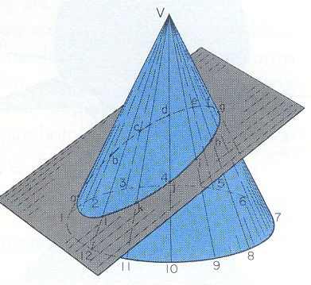
Intersection of a plane and a cone
Method 1: Selected Line Method (When an edge view of the plane is available)
4
3
5
In FV, the cone is seen as a triangle and the plane as EV
Draw lines V-1, V-2 , etc. called ‘elements’ or ‘generators’ in top and front views
The points of intersection of ‘generators’ and EV give the ‘line of intersection’ of plane and cone in FV
Locate the points of intersection (e & i) in the top view
Similarly, locate all other points of intersection in top view and draw the ‘curve of intersection
What will be the shape of the ‘curve of intersection’ in top view?
c
d
e
2
b
6
f
a
v
g
1
7
h
l
i
12
8
k
j
11
9
10
v
g
e
f
Plane in EV
d
i
h
c
j
a
b
k
l
1
2
3
4
5
6
7
12
11
10
9
8

Slide 6
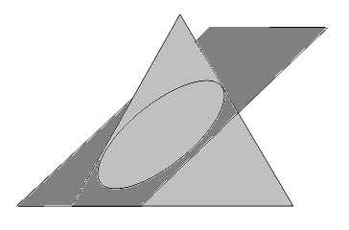
Intersection of a plane and a cone
Method 2: Cutting Plane Method (When an oblique plane cuts the cone)
Draw generators in both top & front views.
Pass a ‘vertical cutting plane’ through generators V-2 & V-8, it will be in EV in top view.
The ‘cutting plane’ cuts the cone in half; and cuts the oblique plane at points X and Z.
Transfer the points X-Z in the front view (connecting line will be a Straight line).
Points of intersection of line X-Z with generators (V-2 & V-8) in front view yield desired ‘points of intersection of cone and the oblique plane’.
Transfer these ‘points of intersection’ (b & h) from front to top view.
Similarly, get all other points of intersection.
4
3
5
2
6
X
b
c
d
e
a
v
f
1
g
7
l
h
Z
12
8
k
i
j
Cutting plane
11
9
10
v
c
d
e
f
g
Z
X
i
h
b
a
j
l
k
1
2
3
4
5
6
7
12
11
10
9
8

Slide 7
Thank You !!!

